Slide 1
Literature Survey
Fire Detection using Surveillance camera on roads
IIIT Lucknow
Submitted by: Akash Papnai
Project Partner: Vipul Chandra
Submitted to: Dr. Deepak Singh

Slide 2
Introduction
Fire causes serious harm to humans, trees as well as animals.
It can happen anywhere, inside or outside.
It should be stopped as soon as possible.
There are various options other than surveillance cameras but they have some major drawbacks.
There are various advantages of using surveillance cameras in place of others things or devices.

Slide 3
About Project Tools
The language we have used to make it work will be Python.
There are two Python modules that will be used in this project:
Opencv
Tensorflow
Opencv will be used to capture the video for video processing.
Tensorflow will be used to train the dataset.

Slide 4
Why Tensorflow
Tensorflow includes keras.
Have more answers than torch in StackOverflow.

Slide 5
How will it work
Flame is not constant, it is moving all the time but color of the flame is same all the time. So, we can use frame difference with RGB color detection model.

Slide 6
Others Contribution to same project

Slide 7
Realization of moving object detection and tracking algorithm based on frame difference method and particle filter algorithm.
This paper was given by Z. Yaoming, W. Chengdong, Z. Yunzhou.
The paper proposed a fire detection method based on the multifeatures of flame, which firstly combined frame difference detection.
In this, frame difference detection operates quickly and no complex calculations are done.

Slide 8
Frame Difference Method
It is a method of motion detection.
Pixel changes are used to detect the motion.

Slide 9
When Particle Filter Algorithm is used
There is something we want to know.
We can measure something, related to what we want to know.
We know something about relationship between measurements and what we want to know.
Relating to fire detection.
We want to determine fire.
We can measure distance from x and y axis of fire from origin on camera.
We have the camera as source
But we don’t know where exactly is fire on camera.

Slide 10
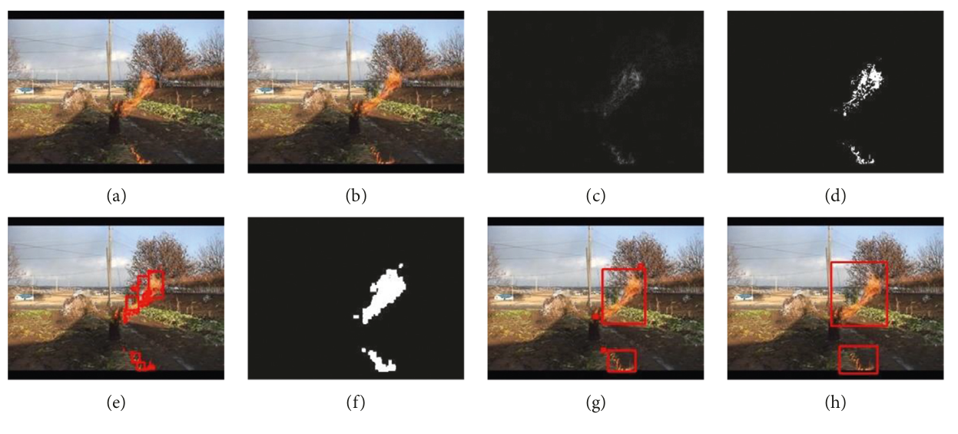
Motion detection due to frame difference

Slide 11
RGB color model based the fire detection algorithm in video sequences on wireless sensor network
This paper was given by Y.-H. Kim, A. Kim, and H.-Y. Jeong.
This is more stable than flame difference and particle filtering model.
Taking into the account the spatial variability, the area variability, boundary complexity, and shape variability properties, the characteristics of the flame are determined by using the number of flame pixel points, the convex hull, and the centroid.

Slide 12
Machine vision based indoor fire detection using static and dynamic features
This paper was given by R. A. Khan, J. Uddin, S. Corraya, and J. Kim.
They proposed a method based on video using flame dynamics and static indoor flame detection, using the color, perimeter, area, and roundness of the flame.
But this is totally ineffective.

Slide 13
Fire Detection Preprocessing

Slide 14
Flame Features
The flame has no fixed shape.
There is disorder in the boundaries of the flame.
The fire location has a certain similarity in the continuous image.

Slide 15
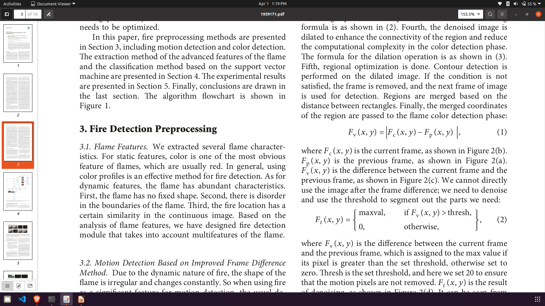
Formula Used
The merged coordinates of the region are passed to the flame color detection phase:
Where,
Current Frame
Previous Frame

Slide 16
Denoising formula,

Slide 17
References
[1] Realization of moving object detection and tracking algorithm based on frame difference method and particle filter algorithm
July 2017
[2] RGB color model based the fire detection algorithm in video sequences on wireless sensor network
April 2014
[3] Machine vision based indoor fire detection using static and dynamic features.
May 2018

Slide 18
Thank you

